Slide 1
各种文书应对策略合集
GGU Consulting 2017

Slide 2
A. 文书的种类概述
CV/Resume;
RL;
PS (Personal Statement), Statement of Purpose (SOP);
Essays: PHS (Personal History Statement); DS (Diversity Statement) …….

Slide 3
B. PS的价值和作用
“以理服人”的情书
为什么你要选择我？
为什么我要选择你？

Slide 4
B. PS的一种结构（结构可以很多）
动机：为什么学这个；(兴趣/渊源/特殊/直接）
学习背景
科研（或者准科研）1+收获
科研（或者准科研）2+收获
实习+收获
课外活动
今后的规划+为什么要读你们的项目

Slide 5
B. PS （1 动机） 例子1
After a series of hard and interesting experience, I realized the power and beauty of statistics. This should be the century of statistics, and I, a young Chinese girl, who is eager to do something to enlarge (maybe only a little bit) human’s understanding of the nature, decided with discretion to devote my future life doing research in this field. This is why I want to apply for the PhD program in XXX.

Slide 6
B. PS （1 动机） 例子2
My first motivation for helping overcome medical challenges via electrical engineering came from the pain and helplessness I experienced when I was 15. My grandfather, who had lived with us all through my childhood years, passed away from cancer. As a boy, I witnessed the battle he fought against cancer. Years of radiation therapy and surgery reduced my grandfather, once a strong man, to a weak body. I can never forget the image of him breathing heavily in his sleep with barely any hair on his head. With a strong desire to heal people with cancer, I decided to devote myself to the study of electrical engineering and biomedical science.

Slide 7
B. PS （1 动机） 例子3
I am Chuan Tian from XXXXX University, Beijing, China. In Chinese, the meaning of “Chuan” and “Tian” are mountains and fields, respectively. Mountains and fields inspired my father when he was a young pilot, and that’s why he chose this name for me. He hoped to think of his dear son each time he saw the landscape. Perhaps he did not foresee that his decision resulted in my indissoluble bond with Geotechnical Engineering.

Slide 8
B. PS （1 动机） 例子4
At the crossroad after a long warming-up journey in nano science, a lecture made me settle the orientation of my PhD researches. This is a fantastic lecture regarding metamaterials and plasmonics made by Prof. XXX in the 2010 XXX Conference, where I witnessed how the nanotechnology realized a Russian Scientist’s dream of negative refractive index after nearly half a century, and how the negative refractive index metamaterials created the magic superlenses, hyperlenses, optical cloak and sub-wavelength devices. After pleasant and enlightened communications with Prof. XXX in four days conference, I determined to explore the numerous treasures in this area. This is why Berkeley XXX is unique for me: it is the lighthouse for my navigation as well as the dreamland I sailed towards.

Slide 9
B. PS （1 动机） 例子5
I was first attracted to the beauty of quantitative finance during my sophomore year when I saw the headlines, "Top quant sees bright future for mathematical finance as it tackles problems thrown up by the crisis" in Risk Magazine. Following a quant finance program held by Morgan Stanley, I gained a much deeper appreciation of how the quantitative methodology can be applied to solving commodities trading and risk management problems. I have always loved the well-defined world of quantitative analysis, and hope to make that my future study and career.

Slide 10
B. 学习背景 例子1
Intensive studying of science subjects in high school prepared me to compete successfully for admission to XXX University in 2009, ranking top 10 out of 80000. To further enhance my quantitative background, I chose Physics, which, though mandatory for engineering students, is uncommon for those in finance. I got perfect marks in that course, and the professor put me in the China Undergraduate Physics Contest. After just a semester’s study of advanced Physics, I was honored with First Prize. Though many of my courses concentrate on economics and finance, I managed to keep an edge over my peers by retaining a mathematical and scientific mindset, which I applied to the financial world. To get closer to my career goal in asset management, I need to advance my understanding of quantitative tools and handle the combination of economic analysis, mathematics and computer science which are becoming increasingly vital in the financial industry.

Slide 11
B. 学习背景 例子2
As chemistry is one of the most basic subjects of environmental science, I chose chemistry as my bachelor’s degree. During my time at XXX University, I studied hard to build a strong foundation of knowledge and looked for various opportunities to learn more about the field of environment. I have gained a lot in my college years, not only in academic ability, but also in leadership.

Slide 12
B. 学习背景 例子3
I myself am a student who has benefited from systematic bilingual education. Since I was in junior one of Nanjing Foreign Language School, I have received systematic English education and training while also studying Chinese. In addition, majoring in English Literature in my undergraduate study not only allowed me to acquire more experience in bilingual acquisition as a practitioner, but also laid a strong foundation for my study in your master’s program and for my future career development.

Slide 13
B. 科研经历 例子1
My first step into the semiconductor world started from the physics arena, where I developed capabilities for exploring nanoscale mechanisms through microstructure fabrication, characterization and simulation. Attracted by the magic idea of employing the charge as well as the spin of electrons in semiconductors, I delved into the domains of diluted magnetic semiconductors (DMS). Understanding the origin of room-temperature ferromagnetism in GaN:Mn DMS is one of the most challenging problems in spintronics, where a main obstacle is the lack of a nanoscale magnetic characterizing method. To overcome this issue, I proposed two new methods using a magnetic force microscope (MFM) and an atomic force microscope (AFM) to investigate the nanoscale etched artificial microstructures and natural dislocation pits in the GaN:Mn thin film. I then created a simulation of the MFM and AFM data and confirmed the long range magnetic order in our MOCVD grown room-temperature ferromagnetic GaN:Mn, which excluded many controversial ferromagnetic origins in GaN:Mn DMS. The representative paper submitted to Physical Review Letter summarized my work on this topic (http://arxiv.org/abs/xxxxxxxxx).

Slide 14
B. 科研经历 例子2
With a solid foundation of knowledge from the classroom, I entered the laboratory in my sophomore year to conduct research in the field of Micro-Electro-Mechanic Systems (MEMS). After mastering various fabrication methods including electron beam lithography (EBL) and reactive ion etching (RIE), I made some functional devices and studied the scallop effect in deep reactive ion etching (DRIE) by building quantitative models. Through a process of continuous optimization, I successfully constructed µm scale microfluid channels with mutiple 100nm scale nanogrid gates to control the flow of the fluids. After completing this research, I received an invitation to present my work at the 9th IEEE International Conference on Nano/Micro Engineered and Molecular Systems (IEEE NEMS’14). In addition to this, we also filed a Chinese Invention patent to protect these research results because of strong possibility for applying them in the industry.

Slide 15
B. 科研经历 例子3
As I learned more about this field, I gradually realized that new materials will bring revolutionary progress to our world someday. Therefore, I decided to step out of the field of traditional silicon-based devices, and joined Professor Zhongfan Liu’s group in the Center for Nanochemistry, a leading research institution for 2D materials and topological insulators (TIs) in China. For this project, I investigated transparent electrodes based on TI surface states, which exhibited robust transport characteristics because the elastic backscattering of nonmagnetic impurities was prohibited. To promote the transmittance as well as the contribution of surface states, I fabricated topological insulator Bi_2 Se_3 nanostructures using selective-are Van der Waals epitaxy with my group members. As a result, light transmittance in this high-performance TI transparent flexible electrode was improved by 30% in a broad range of conditions compared with our preliminary trials, and was even higher than ITO’s transmittance in the near-infrared region. Upon completion of this research, we submitted our results for publication and it was included in the 2013 edition of Advanced Materials.

Slide 16
B. 科研经历 例子4
After studying the optical, mechanical, and transport characteristics of the topological insulator Bi_2 Se_3 thin film at room temperature, I was then curious to explore some of the intrinsic qualities of Bi_2 Se_3 under ultra-low temperatures. So, in my current project, I explored magneto-resistance in a Bi_2 Se_3 Hall bar device with a partner from the Institute of Physical Electronics in Peking University. By utilizing the new laboratory skills that I developed from my previous project, I successfully prepared a single crystal Bi_2 Se_3 thin film, characterized its surface morphology with atomic force microscopy (AFM), fabricated a Hall bar device, and then measured its transport characteristics in ultra-low temperatures. To solve the phase coherence length saturation problem, I used some outside references and determined the influences of electron-electron interactions and the heating effect by checking the R-T and I-V curves. Now, with the weak antilocalization (WAL) and high magnetic field data that we collected during ultra-low temperatures (40 mK), we have completed our research and are preparing to report our results.

Slide 17
B. 科研经历 例子5
As a person, I enjoy friendly competition. In February 2013, I led two teammates to take part in the National College Mathematical Contest in Modeling. During this contest, our team used graph theory to build a model for identifying the most important professor from an academic database based primarily on peer citation. I implemented the model in C++ and also noticed that this approach could similarly be applied to identifying the most influential users in a social network, and since we had time, our team built another application based on this observation. Because of our efforts, we won the Meritorious Winner Award. This experience gave me confidence in my modeling skills and surprisingly helped me prepare for my current internship.

Slide 18
B. 科研经历 例子6
To learn more about the scientific language education research method, in July of 2015, I went to XX to work on the Word Generation project under Professor XX’s supervision. This project aimed to improve English learning efficiency and students’ abilities to use academic language to express their own perspectives on social issues, especially focusing on students with bilingual backgrounds. During this experience, I mainly analyzed syntax use, vocabulary, and students’ perspective-taking abilities in essays written in this teaching project. To contribute to the Word Generation project, I discovered that this project placed significant emphasis on learning academic vocabulary and less emphasis on learning grammar and sentence structures. As a result, due to deficiencies in grammar knowledge, students experienced difficulties in linking academic words to logical thoughts while expressing perspectives. My insights received praise from Professor XX. This research experience allowed me to grasp basic methods of educational study and enhanced my understanding of features of bilingual students’ language cognition. More importantly, influenced by the United States’ outstanding research capabilities in literacy research, I recognized that there was a great gap between me and these renowned experts, strengthening my determination to pursue further study.

Slide 19
B. 实习经历 例子1
I believe that the rich entrepreneurship and business experiences of my undergraduate years, particularly in the TMT industry, are quite unique within your applicant pool. As a Co-founder of a C2C platform for online tutoring and academic consultancy, I have a deep understanding of the valuation and growth process of a company from an owner’s, rather than investor’s, perspective. In addition to leading my own company, I created the Start-up Club at Tsinghua University from scratch, devoting myself to stimulating entrepreneurial spirit at Tsinghua. Bringing together a collection of promising start-up projects, I worked on building team cohesion, coordinating the team as a whole, handling emergencies, maintaining a close relationship with the university, and competing with other clubs for resources. Starting and managing both a company and a student organization have taught me the art of being a leader, a capability that will be vital to the success of my career. I hope eventually to be a resource for the other members of your community, sharing my firsthand experiences with students and teachers in your program.

Slide 20
B. 实习经历 例子2
Realizing that pursuing a career in the financial sector entails both theory and practice, I challenged myself to take an internship at the Investment Banking Division in the head office of China Construction Bank, one of the largest banks in China by market capitalization. During my internship, I was placed in a team in Private Placement Bonds in the fixed income division. Our team leader was once required to survey the status quo of Private Placement Bonds in China. He got stuck because the data was not in a standard format readily amenable to analysis in Microsoft Excel. Based on the source data, I developed a C++ program that automatically and accurately transformed the massive data set into the standard format in a split of a second and clearly marked the places for missing data where manual input was necessary. The team leader was deeply impressed by my problem-solving skills. I was able to revise the contracts and review the documents of the bonds and clarify the risks behind them using the financial data. At the end of my internship, the team leader said I was the best intern he had ever seen. Moreover, my colleagues spoke highly of my quick response and teamwork.

Slide 21
B. 课外活动 例子
Nevertheless, true creativity does not come from science alone; it comes from the combination of humanity and science. Having not only a strong curiosity in science, I also have humanistic care for the people around me. Though I got the precious chance to study at XXX University, I understand that many talented kids do not have the chance to pursue education because of poverty or social bias. With the strong wish to decrease inequality and reciprocate to society with my knowledge, I actively participated in the volunteer teaching activity for migrant children, spending days teaching them English. The feeling of content I felt when the kids finally learned how to use the phrase, “as soon as” to make a sentence was no less than what I felt when I learned things. I also felt the need to give attention and help to old people whose children were not by their side. Therefore, I spent my time visiting an old retired professor of XX University every weekend. When sharing with him stories of my campus life and cooking dinner for him, it felt just like caring for my own grandfather. Various types of volunteer work enlarged my horizon and let me view the world from broader angles. Volunteer experience at the Cross-Strait Exchange Association let me perceive the diversity of culture and society. Peking Marathon’s voluntary service also led me to feel the robustness and activeness of life. Moreover, my internship in the cosmetic and pharmaceutical industry made me perceive the meaning of caring, giving me a stronger desire to create better products for people.

Slide 22
B.今后的规划+为什么要读你们的项目
Through my previous studies and research experiences, I have constructed a strong background in environmental engineering as well as the application of petroleum work， and have also fostered proficiency in numerical simulation as well as experimental studies, which will lead me to excel in future research. At the same time, I have developed a clearer goal and plan for my future: I wish to dedicate myself to the research in the field of energy engineering. Thus, I envision the M.S. program in Mechanical Engineering at the MIT Energy Initiative as an ideal platform to further extend my knowledge. Research on advanced fluid mechanics, conducted by Professor XXX XXX, largely overlaps with my long-lasting interests and previous research experiences. I am also interested in Professor XX XXX’s research on microbial fuel cell. I deeply hope that I will have the invaluable opportunity to pursue my graduate studies at the Mechanical Engineering Department.

Slide 23
B.今后的规划+为什么要读你们的项目
I plan to leverage on the Master in Finance program in Princeton to reach my objective. Princeton is well-recognized for its academic rigor. Beyond a strong emphasis on computational methods, the program highlights a comprehensive approach to finance, covering financial economics, corporate finance and other areas necessary to my career. The small class size provides personalized learning opportunity, in particular, the master’s research projects, which can enhance my problem-solving ability in advanced topics. Further, the cohesive networks with alumni and professionals, supported by Advisory Council and Corporate Affiliates, will offer me a unique advantage both when hunting for placement in the US and when starting my own business. I am confident that I can build on my quantitative competence and my well-rounded experience in MFin, to excel in the job market, and to become a leader in the future.

Slide 24
C. Essay, PHS
1、Who am I, I=quality 1 + quality 2 + quality 3
2、quality 1+论证
3、quality 2+论证
4、quality 3+论证
5、Who am I 决定了 What I am going to do.

Slide 25
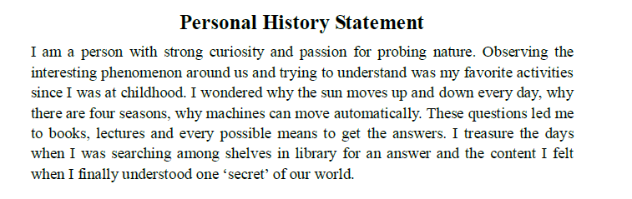
C. Essay, PHS
1.

Slide 26
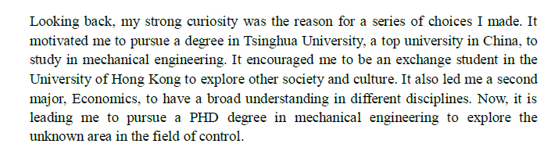
C. Essay, PHS
2.

Slide 27
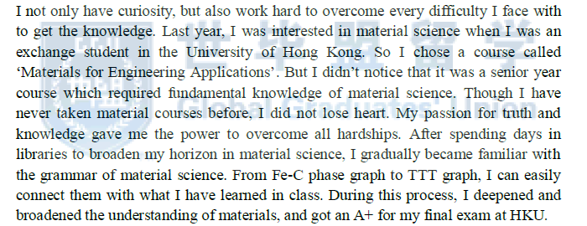
C. Essay, PHS
3.

Slide 28
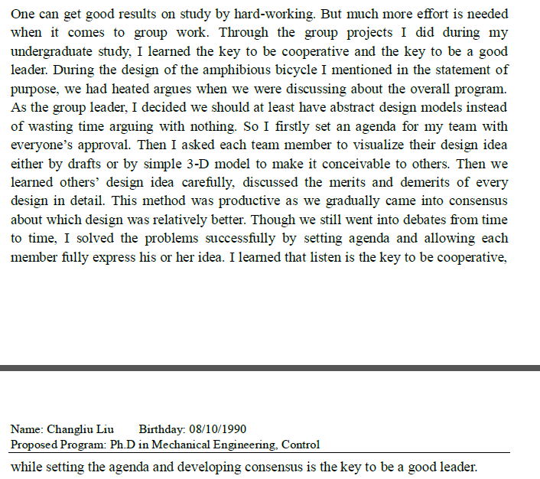
C. Essay, PHS
4.

Slide 29
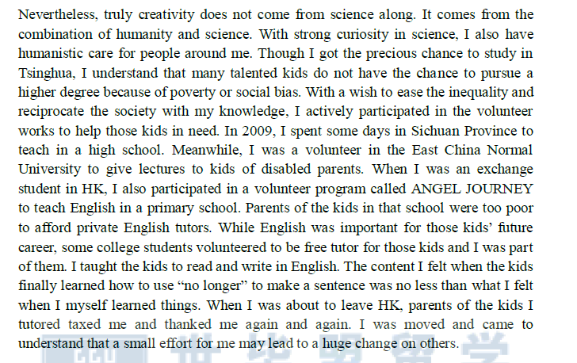
C. Essay, PHS
5.

Slide 30
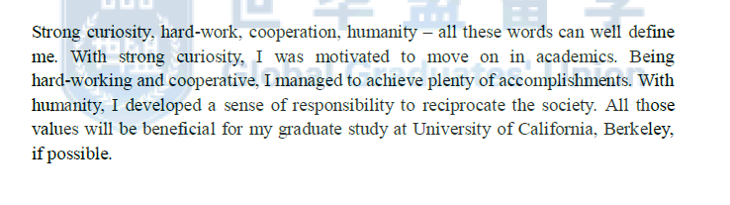
C. Essay, PHS
6.

Slide 31
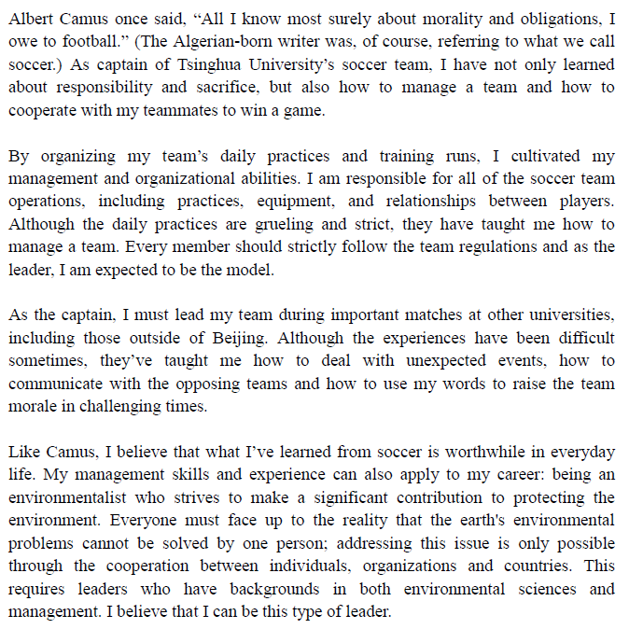
C. Essay, DS

Slide 32
补充内容：
软实力 v. 硬实力？
软实力包含的内容有哪些？
——包括但不限于：
领导力
团队合作
成功/失败
坚毅
道德困境…

Slide 33
补充内容：
通过两小时的课程提升软实力？
——No.
本课程的目标/主旨？
——通过一节课的时间，让大家清楚地知道如何在申请中去展示自己的软实力。
软实力在申请中的比重？
——PS中的必要段落；各类Essay的主题写作；
——同等硬件条件下脱颖而出的筹码。

Slide 34
补充内容：
通过举例前辈们成功将自己软实力展现出来的文书范例，启迪各位展现自身软实力文书的写作思绪。
从常见的五个软实力角度分别展示各类软实力的不同写作逻辑，强调写作要点。
需要同学们关注和思考：
1）范例的优点？
2）是否存在潜在的相似写作逻辑？
3）一篇好的文书最关键的特点是什么？

Slide 35
领导力：
领导力的体现并不一定需要“高大上”的背景，也不是把重大的项目的功劳占为己有；相对而言，因领导力取得的成绩远不如你从这段经历中所获得的东西那么重要（which is, 描述过程>描述结果）。
领导力可能来自团队协作，来自引导组织变革，也可能来自危难之际做出明智决定。
领导力可以有多种体现：
➢ 知人善用
➢ 执行力强
➢ 领导方法（充分沟通）
➢ 从善如流
➢ 胸怀宽广（正确面对批评）
➢ 说服他人（理性分析）…

Slide 36
领导力：
领导力的体现并不一定需要“高大上”的背景，也不是把重大的项目的功劳占为己有；相对而言，因领导力取得的成绩远不如你从这段经历中所获得的东西那么重要（which is, 描述过程>描述结果）。
领导力可能来自团队协作，来自引导组织变革，也可能来自危难之际做出明智决定。
领导力可以有多种体现：
知人善用
执行力强
领导方法（充分沟通）
从善如流
胸怀宽广（正确面对批评）
说服他人（理性分析）…

Slide 37
领导力范文：
Academic and work experience aside, I am also a big fan of soccer and am now the honored captain of our school’s soccer team. The team was incredibly weak when I first joined, but over time I gradually led it to success, the most significant achievement in my life. Here is how it happened.
As I have enjoyed playing football since I was very young, I’ve dreamed about winning the championship in the Tsinghua Annual Soccer Competition since I entered the university. To my surprise, however, when I tried to build a class football team I found that hardly anyone was really interested. Even though I eventually persuaded enough classmates to join in, no one attended our routine training. As a result, we were knocked out in the first round my freshman year.

Slide 38
领导力范文：
After this failure, I knew if we wanted to win something in the next few years, we needed to be a real team. As the famous football coach Bora Milutinovic once said, ‘attitude is everything.’ I believed that the most important thing to do was to make everyone on the team enjoy playing football rather than to force them to join the training session. I routinely shared legendary stories like The Miracle of Bern, Total Football and Roberto Baggio on the 1994 World Cup with my teammates. I tried to show them the beauty of soccer including courage, innovation and uncertainty by organizing FA Premier League game watching parties on Friday nights.

Slide 39
领导力范文：
Steadily I felt the atmosphere of playing soccer being integrated into our school, and our soccer team finally managed to get to the semi-final round in my senior year in Tsinghua. It was a huge achievement in our school’s team history. Even though we didn’t make it to the final game, in my teammates’ regretful eyes and comforting words, I suddenly realized we had truly become a real team – winning the game had become our team’s goal rather than my own pursuit.
In all these years as the team captain, I never used my power to give orders; instead I shared my understanding and love of soccer with my teammates, which ultimately built a competitive soccer team in my school. After all this I realized that sometimes leadership does not have to entail orders or power. Instead, good leadership is often about sincerity and constancy of insistence. This milestone achievement made me recognize the importance of hard work and perseverance, but also reminded me of the overriding impact of team unity and spirit on a group’s success. To achieve anything as a leader, one must first win over the hearts and minds of the people one is leading.

Slide 40
团队合作：
所谓团队合作能力，是指建立在团队的基础之上，发挥团队精神、互补互助以达到团队最大工作效率的能力。对于团队的成员来说，不仅要有个人能力，更需要使得不同位置上的成员各尽所能、与他们有效地协调合作。
➢ 包容成员
➢ 资源共享
➢ 保持谦虚
➢ 特点互补
➢ 尊重
➢ 欣赏
➢ 宽容
➢ 信任…

Slide 41
团队合作：
In 2011, I led a 3-member team in the National Undergraduate Electronic Design Contest, which challenged students to build two cars for racing on a rectangular track. In designing the sensor circuits, the biggest challenge for me was to find a way to make a car turn precisely 90 degrees. Inspired by the GPS in smartphones, I tried a new way to make the car turn 90 degrees that no one had ever used before – using a digital compass.
Unfortunately, I soon discovered why no one had used this method before. Although we tested our code and circuits countless times, the digital compass just wouldn’t work once it was placed on the car. We were perplexed and we almost missed the deadline before I recalled a quite fundamental parcel of knowledge from my electrical machinery class: part of the motor we used included a permanent magnet, which would interfere with the magnetometer of the digital compass if they were placed too close together, so the digital compass couldn’t work on the car.

Slide 42
团队合作：
Forced to abandon the seemingly brilliant idea of using a digital compass, we developed a new method of turning the car by controlling the difference between the left wheel’s amount of rotations and that of the right wheel of the car. Drawing upon the research literature, we found out that this could be achieved successfully by using a servo motor and a servo motor encoder. So we learned how to use the servo motor quickly, built the drive circuit and the sensor circuit for the encoder and finally enabled the car to turn at a 90°angle before the deadline.
This experience taught me that a holistic approach that combines scientific and engineering processes is necessary in order to avoid situations where parts work in insolation but not in tandem. Moreover, just as each part must come together to form a coherent machine, so too must individuals come together to form a coherent team – teamwork and collaboration are key ingredients to success as an engineer.

Slide 43
失败的经历：
为什么需要描述“失败”？
——如果不费吹灰之力，你就可以得到你要的一切，那么你将永远不会成熟和成长。
写作关于“失败”的事例的关键：
——描述如何面对逆境，将你所经历的挫折转换为积极的东西。不要花太多笔墨描绘失败后的负面情绪，而需要把重点放在怎么解决问题，以及从失败中学到了什么。
结构要求简单，上下文层次递进：失败、后果、教训、解决，以及对于今后类似情况下自己不同举措的心得。
——我们都曾失败过多次（不管是因为主观还是客观原因），但是我们应该感谢这一切；失败意味着你曾经尝试过，而难能可贵的是你可以从错误中不断学习、不断成长。

Slide 44
失败的经历：
I have learned many things from my various experiences, but one in particular taught me that staying on the path towards right can be more difficult than it seems.
While I was working as a leader for my start-up project, I learned that sometimes one must take responsibility for the group, even if it means abandoning one’s personal integrity. When my team was doing a presentation to show our project, the venture capital manager suddenly pointed out a crucial mistake in our data analysis. I recognized instantly that this mistake was made by the other member in our team. However, during this moment of crisis, she kept silent. The manager grew irked by our failure to account for the mistake that he had spotted, and the environment grew tense. Should I point out the culprit, in front of our potential investor? My honesty demanded that I do so, yet my obligation to my team required that I keep silent. After all, speaking up might make the manager suspect that our team was not united. And a fractured team is a risky investment.

Slide 45
失败的经历：
Finally I realized that the only way to reassure the manager and move forward would be to step up and say the wrong data was my fault. But I hesitated. It was not my fault, why should I lie only to hurt myself? After a few minutes of freezing silence, the manager became so angry and uncomfortable that he refused to work with us. I think the frustration I felt at that time was the worst in my life. I suffered a lot from the shame that I failed to take responsibility.
This unforgettable experience inspired me to recognize that in order to achieve the goal of a team or a company, there must be someone to take the responsibility, even if he or she may feel wronged.
My experience has taught me that sometimes, doing the right thing is far more complicated and difficult than it seems. Managing the pushes and pulls of my inner morality and my team’s collective goals can be a delicate balance, where sometimes there is no clear answer. Looking back, I wish that I had acted
differently; but that wish has also motivated me to make the right decision the next time such a dilemma comes around. Next time, I will be ready, and when the time comes, I will act.

Slide 46
坚持：
坚持，是一个持续的过程，这个过程必定伴随着疲劳、不安、彷徨、怀疑和担忧；同时也伴随着隐忍、自我安慰、自我激发、咬牙、克己甚至是突围。
坚持是伟大/有意义成功的前奏，是取得成绩的必要条件。
行文所描述的坚持，必须是在客观条件下，按照普遍的价值观，大多数申请者都会放弃的情况，而你选择了继续前进：不仅要展示自己的勇气和精神，同样要展示自己的自信、思辨等其他品质，以及不断向生活学习的精神。

Slide 47
坚持：
I’ve had many chances to delve deeply into the area of science, but one research project stands out in particular. This project involved an investigation of the toxicity levels of recycled water, and how that in turn affects the environment, which taught me about persistence in the face of failure.
The purpose of the research project was to evaluate the toxicity of secondary effluent in order to determine reused water’s impact on the environment. First, we surveyed the available scientific literature on secondary effluent and settled on the use of the Daphnia Magna, a type of flea, as the toxicity indicate organism, and we cultivated the organisms for four months. Before we could employ the fleas to test the toxicity of the secondary effluent, however, disaster struck when the fleas began dying in droves for unknown reasons. Months of hard work disappeared practically overnight, and we were in danger of failing to meet our deadline. Instead of panicking, however, I searched quickly for possible replacements, and discovered that we could use Zebrafish eggs to achieve the same result without falling behind schedule. Despite our setback, we were able to proceed with the experiment. We extracted organic pollutants from the secondary effluent and arranged the sewage samples into varying levels of toxicity. Then we placed the zebrafish eggs in the samples and observed the effect of the toxicity level on the zebrafishes’ hatching, deformity, and mortality rates.

Slide 48
坚持：
This experience taught me of the importance of perseverance – of continuing to pursue a goal even when everything one has built up in the pursuit of it has collapsed in utter failure. It also taught me of the importance of decisive decision --- making to escape dire situations. It wasn’t easy to abandon all the work we’d done in raising the Dapnia Magna, but doing so was necessary to keep the project alive. Sometimes, success required breaking away from the textbook ideals and taking some risks.

Slide 49
道德困境：
这是院校在考察申请者的moral integrity。
你应该表现出你对生活中哪些模棱两可的“灰色区域”的鲜明的看法，即你的处事原则是什么。
道德的困境会有多种多样的形式和背景；有些可以简单地在说出真相和撒谎之间做出选择，而其他的也许不得不涉及到个人的价值观念和社会的普遍行为之间的冲突。
描写道德困境的文章，切记需要说明你的思维过程，以及你个人的道德观和信仰所起到的作用。

Slide 50
道德困境：
One of my first consulting jobs was an internship at a securities company in XXXX. While I was preparing a presentation to introduce our company to a new client, my supervisor instructed me to secretly change the numbers to make the company’s performance more impressive. After a second of naïvely considering doing as he’d asked, I realized that doing so would be, simply put, flat out wrong.
Unlike money, integrity is not something that can be bought, sold, stolen or faked. While my wealth and social status may define who I am to society, my integrity defines who I am to myself. It is one characteristic that I hold most dear. And so I disobeyed my boss and did not cheat on the numbers, and as a result we failed to attract that client’s investment. What is worse, I lost my internship at that company.

Slide 51
道德困境：
However, looking back, I do not regret what I have done. In fact, I am now a better person for it.
My long-term goal is still to be a Principal at a world class private equity firm, but now I recognize the realities of the dilemmas I will face in such a position. That time at that XXX Company I sacrificed my job for my morality, and I know that I made the right decision. Though at the time my internship seemed like the most important thing in the world to me, I now recognize how fleeting and superficial it actually was. I now know that sometimes I will be forced to choose between the right action and the most profitable action; but I also know that I will always choose the former over the latter.

Slide 52
GGU文书黄金逻辑：
——SWCAOS写法
Situation: 实习、科研或者课外活动发生时的环境；
What:自己做了什么（分类别详述）？
Challenge: 遇到了什么困难和挑战，无挑战即无品质；
Action: 你做了什么？要说明为什么这么做；
Outcome: 即自己的行为最终促使了什么样的积极结果，注意，这个结果必须是超出一般的expectation的；
Significance(or self-examination)：即这件事情对自己的意义何在，自己有什么收获。

Slide 53
Weekly Self-report示范
Title: Weekly Report of Bimeng SHI (08) (2014/07/10-2014/07/16)
I. Introduction
a. Review: briefly review what you have done in the past several weeks;
b. Introduction: briefly introduce what you have done in this week.
II. Progress
a. Illustrates your progress in this week in details;
b. Include data, figures, experimental/theoretical results;
c. Use the format and language of scientific publications in your field.
III. Summary
a. Summarize your work in this week;
b. Try to divide summaries into points: like (1) ………………… (2)…………………(3)…………..
IV. Future Work
List several work you plan to do in the next work.
Reference: [1]….. [2]…..

Slide 54

Q&A

